Slide 1
Intelligent Notification System(INS)
A smart way of managing events at UTD

Slide 2
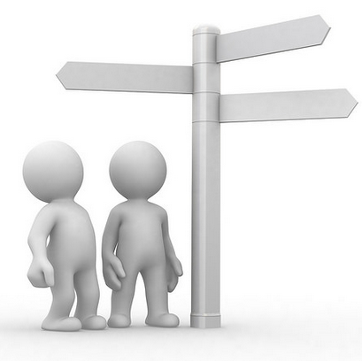
OVER VIEW
RDD of Uses Cases Using Sequence Diagram
Sign Up & Log In
Edit Preference
Event Retrieval
Three Tier Architecture
Domain Model
Class Diagram
Project and Team Management
Working Demo
Plans for the Iteration 3.

Slide 3
VISION AND GLOSSARY
High-Level Goals
Create a user sign up page. One time process for every user.
Ability of the user (those who signed up) to login and manage their preferences.
Create a preferences section based on events categorization. This will be reflected on the UI as well as DB
Maintain a database for users (who signed up) for the application and for events extracted
Monitor the events database regularly to check the new events as well as expired events
Maintain the users database to reflect their modified preferences
Send sms to the respective user 15 mins before the start of the event (based on his selected preferences)
Constraints
User needs to sign up with the system (one time process).
User needs to verify his validity by entering the passcode he receives from the email after sign up.
User needs to select his preferences and currently enrolled class number and section.
User needs to have a mobile where he can get a notification using sms.

Slide 4
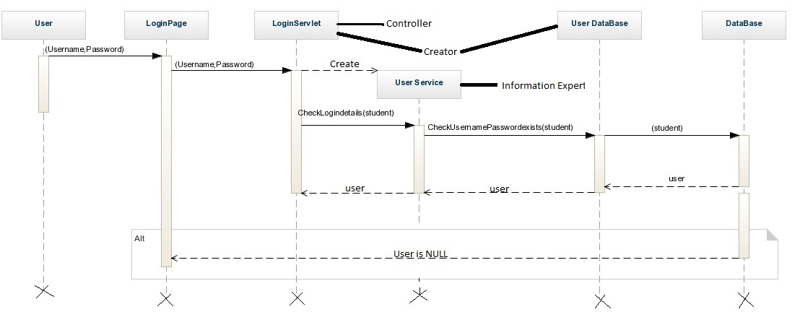
RDD of Uses Cases Using Sequence Diagram Login

Slide 5
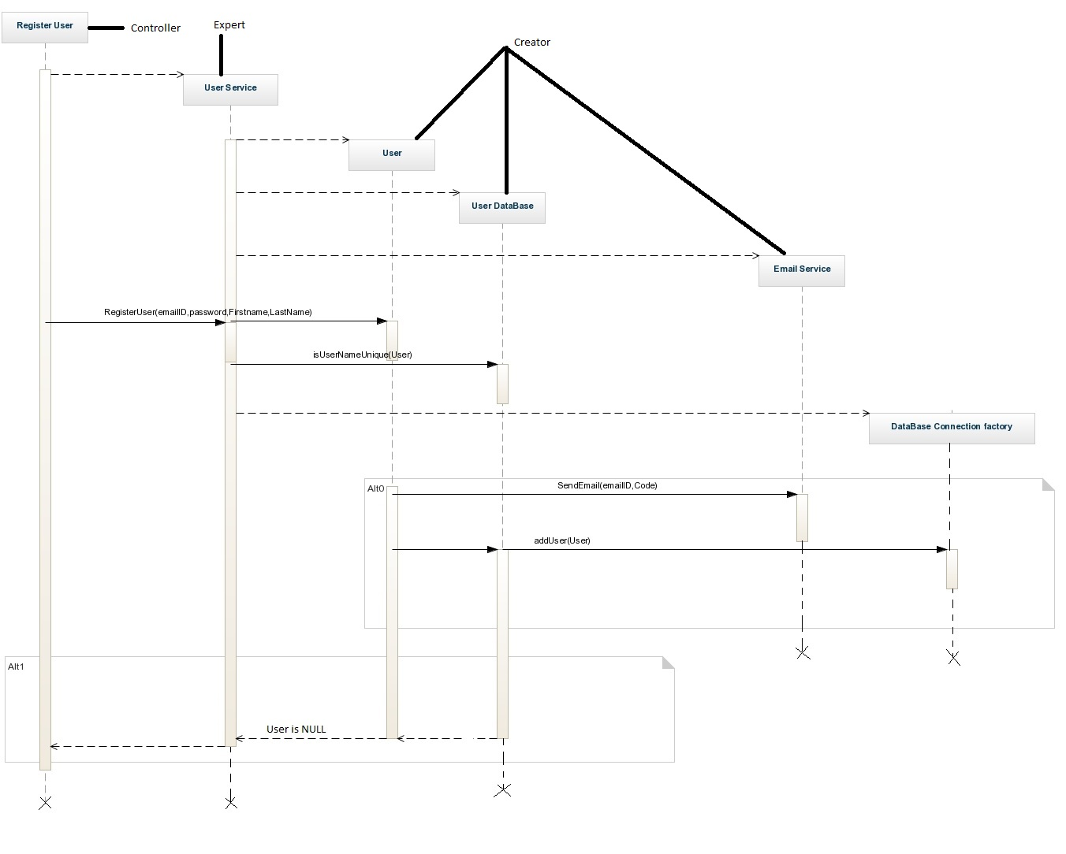
RDD of Uses Cases Using Sequence Diagram Signup

Slide 6
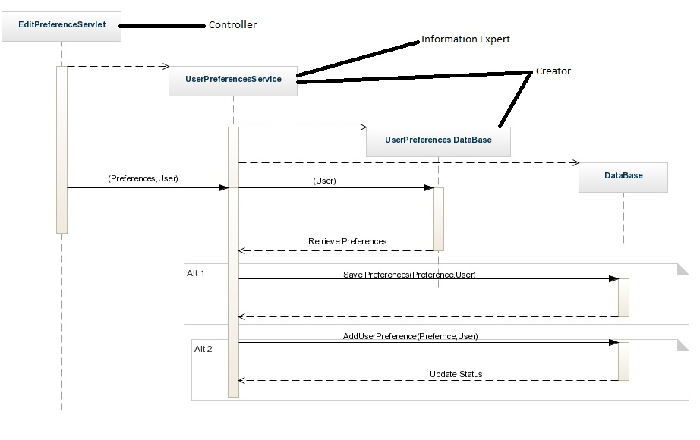
RDD of Uses Cases Using Sequence Diagram Edit Preferences

Slide 7
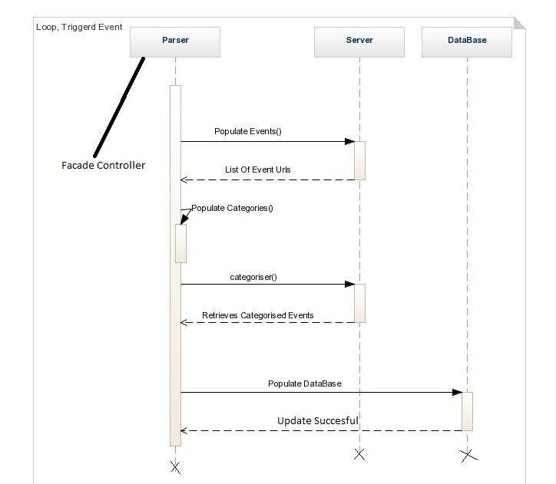
RDD of Uses Cases Using Sequence Diagram Event Extraction

Slide 8
Design Pattern -Three Tier Architecture
Client Computer
Client Computer
Client Tier
INS User Interface
INS User Interface
Web And Application Server
Application
Tier
Web Server
Application Server
INS Application
Event Extractor
Data Tier
Database Server
INS Database

Slide 9
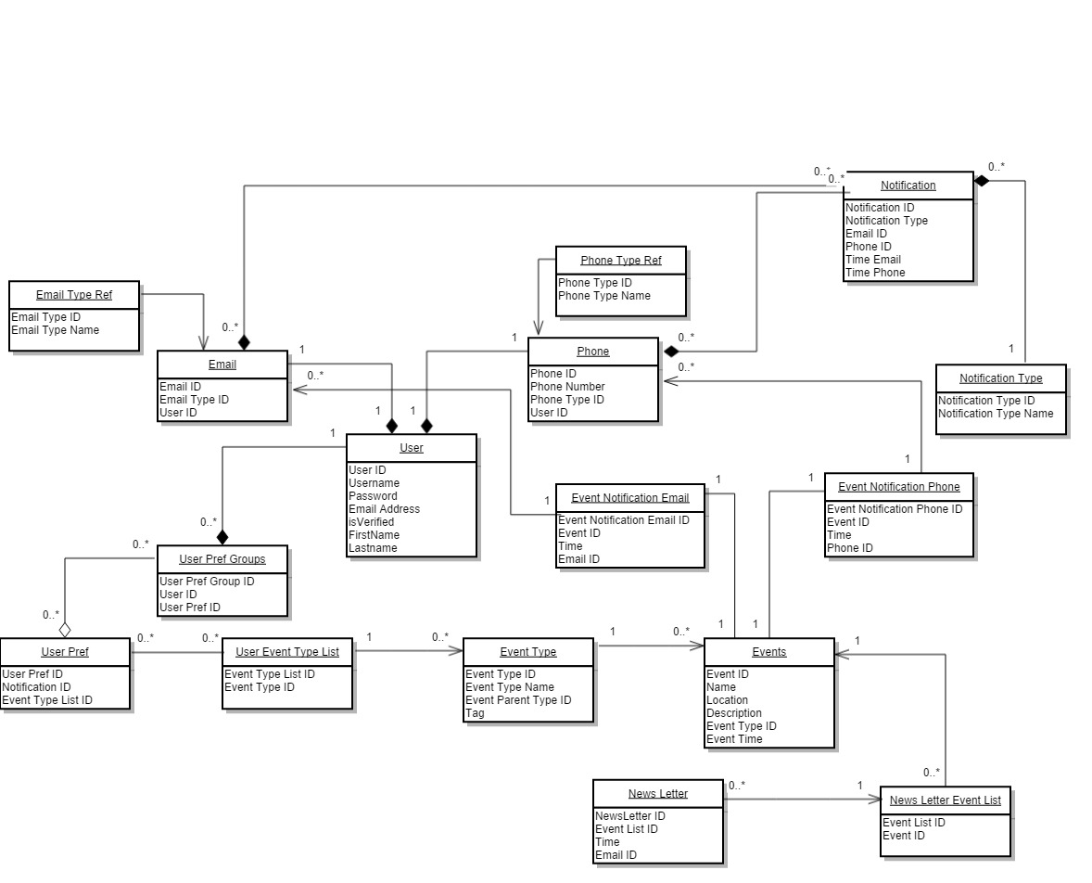
DOMAIN MODEL

Slide 10
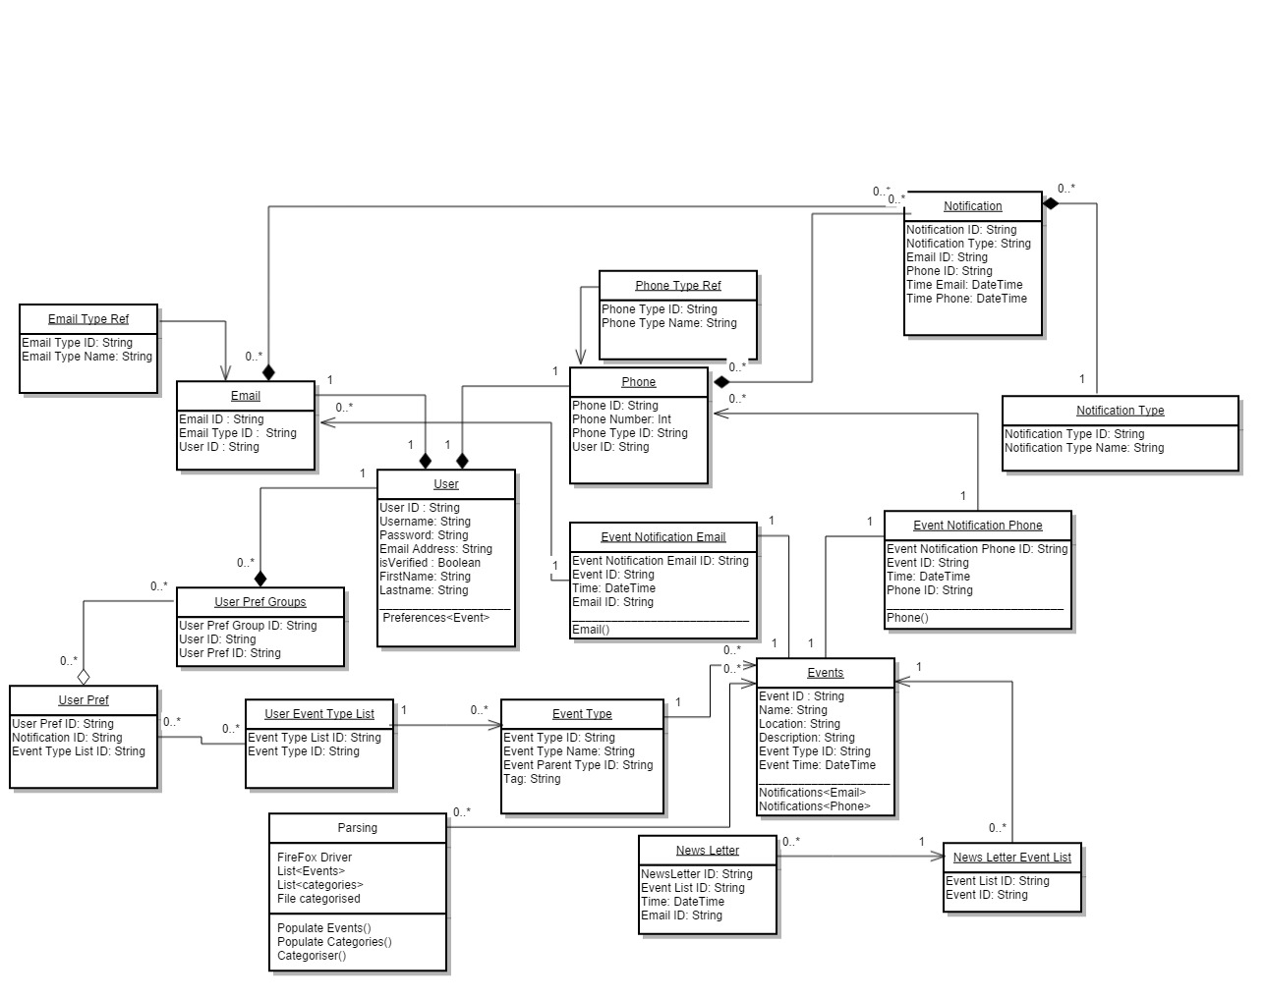
CLASS DIAGRAM

Slide 11
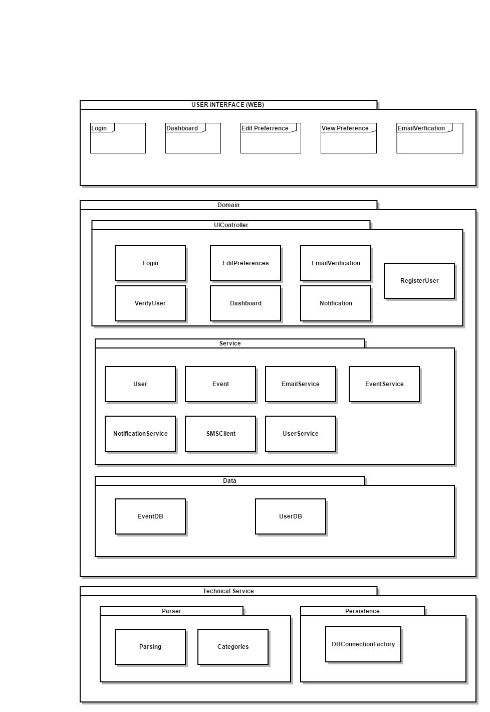
PACKAGE DIAGRAM

Slide 12
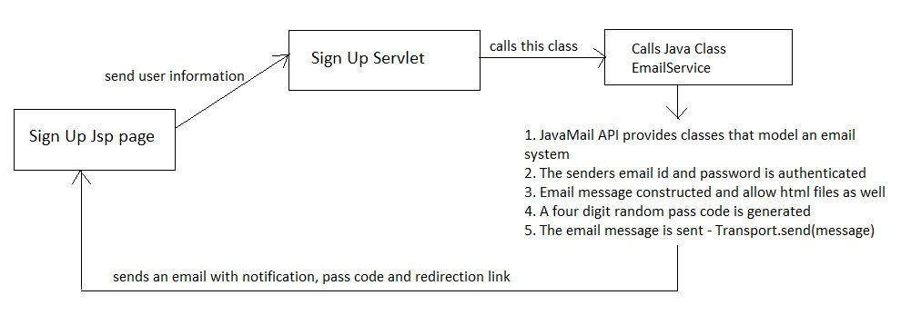
SIGN UP FLOW

Slide 13
EVENT RETRIEVAL
Selenium is used for scraping through the web pages.
The page is parsed through to fetch events.
The category list generated is used to classify the events.
The event page is parsed through to fetch the event description and to determine the categories the event belongs to.
The categorized list is updated in the database.

Slide 14
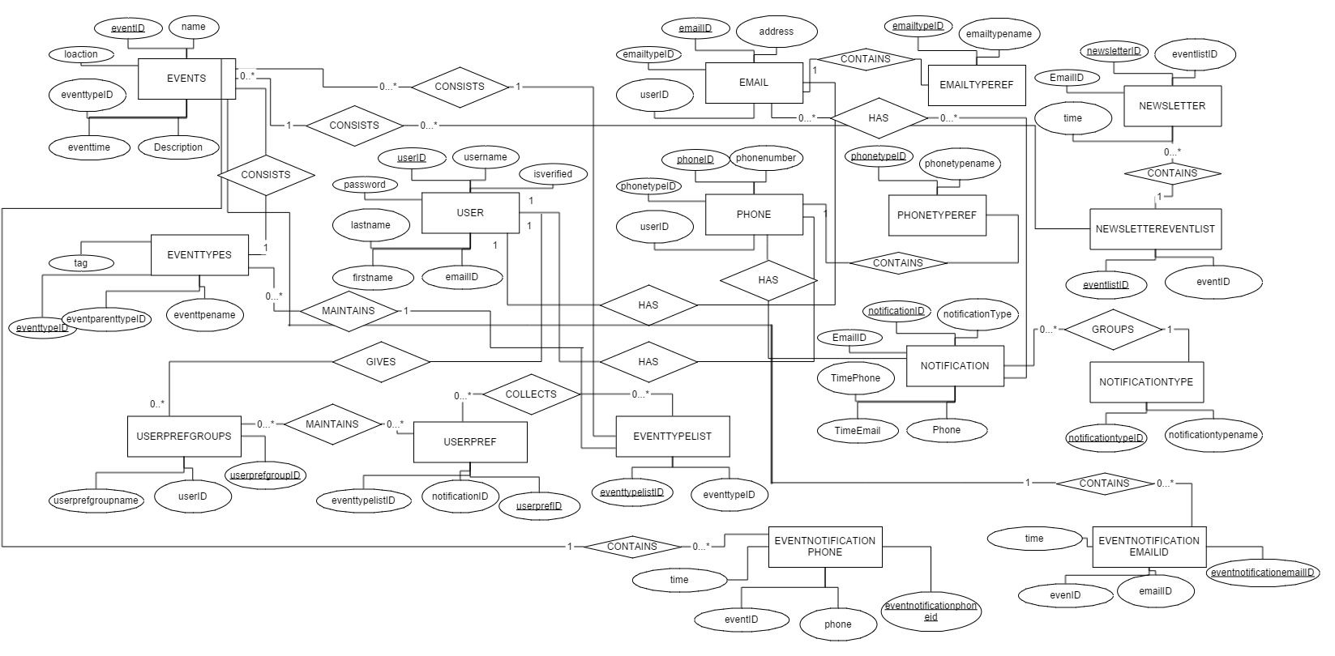

Slide 15
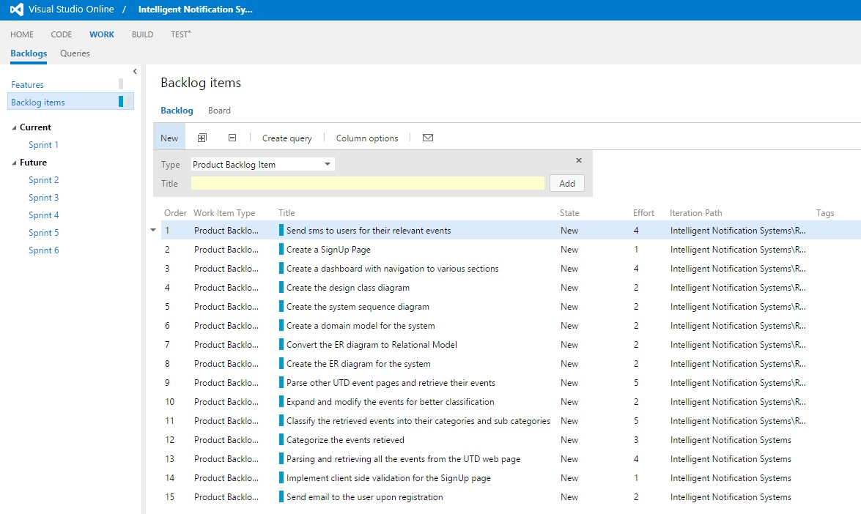
PROJECT MANAGEMENT

Slide 16
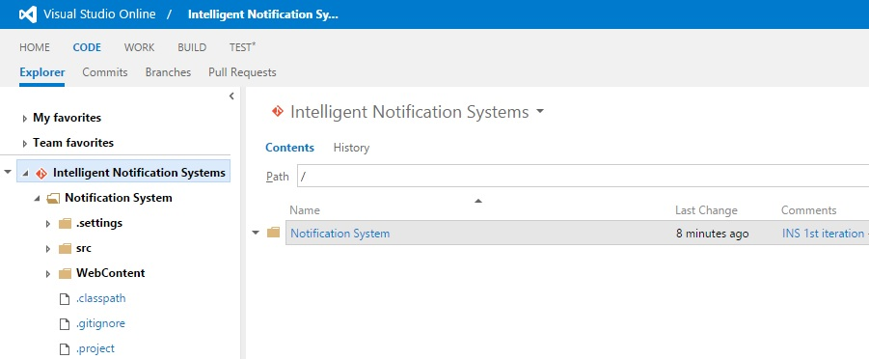
COMMON WORKSPACE

Slide 17

WORKING DEMO

Slide 18


PLANS FOR ITERATION 2
Sending Notification
Enhancement of Edit Preferences
Enhancements for Event Extraction

